Slide 1
Oauth 2.0

Slide 2
Two Fundamental Steps
Issuing a Token
The token represents the access that’s been delegated to the client and it plays a central role in every part of OAuth 2.0
Using a Token

Slide 3
Sequence of Events
1. The Resource Owner indicates to the Client that they would like the Client to act on their behalf
2. The Client requests authorization from the Resource Owner at the Authorization Server.
3. The Resource Owner grants authorization to the Client.
4. The Client receives a Token from the Authorization Server.
5. The Client presents the Token to the Protected Resource.

Slide 4
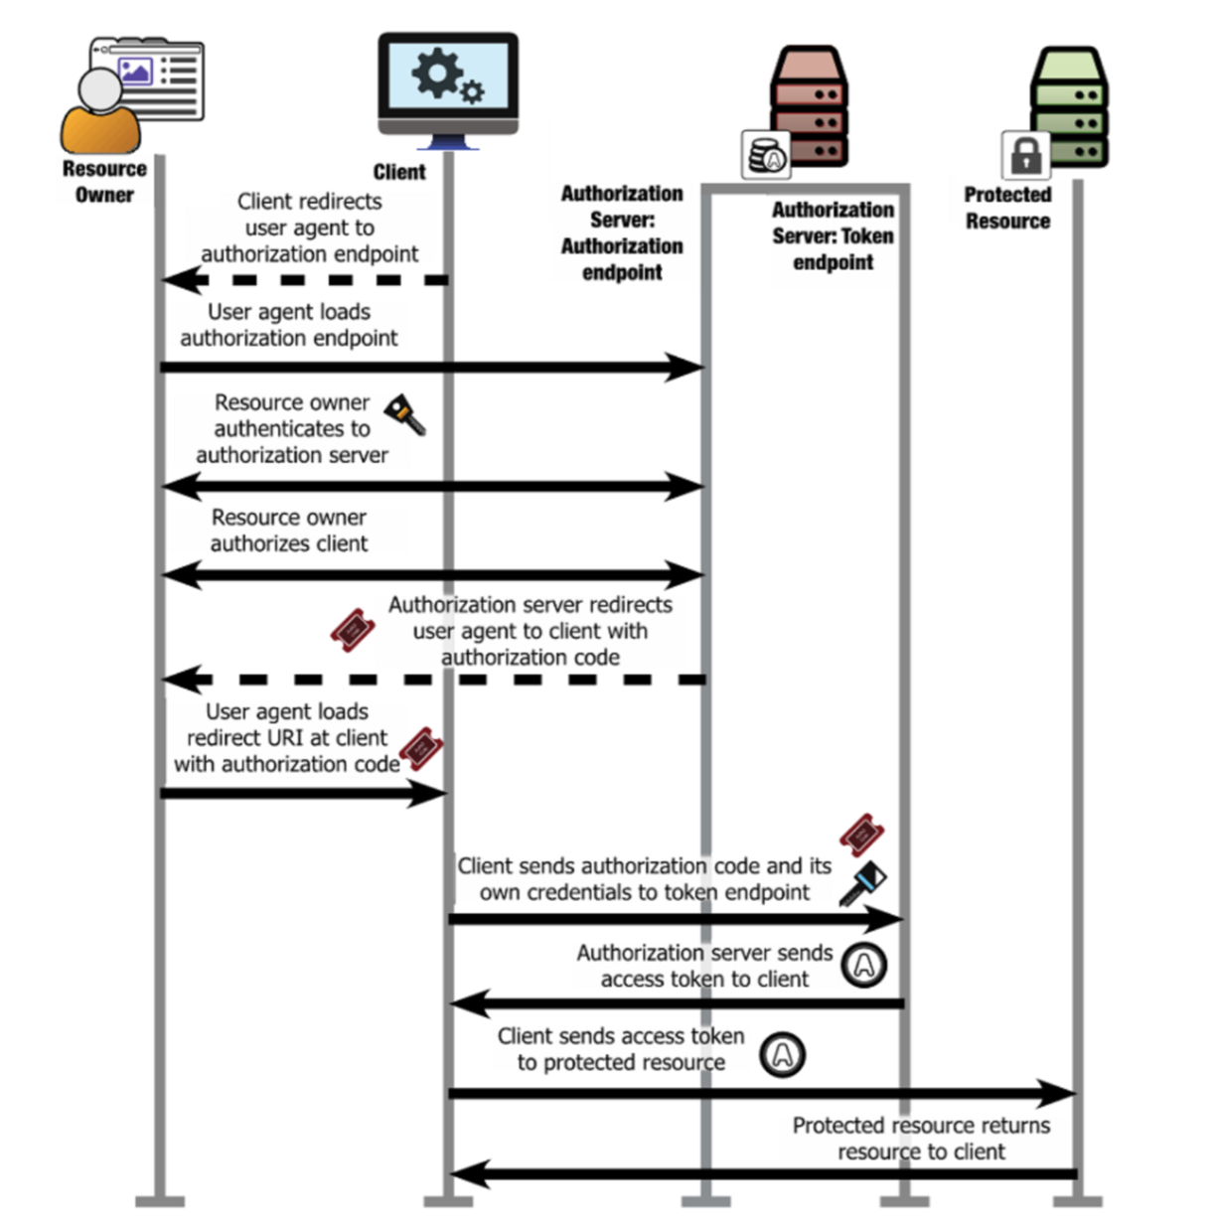

Slide 5
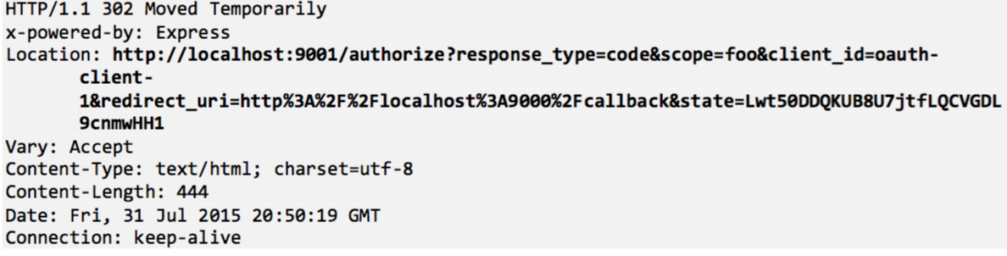
Redirect – Client’s Response
Client’s response to redirect user (browser) to Authorization Server
Happens just in the browser

Slide 6
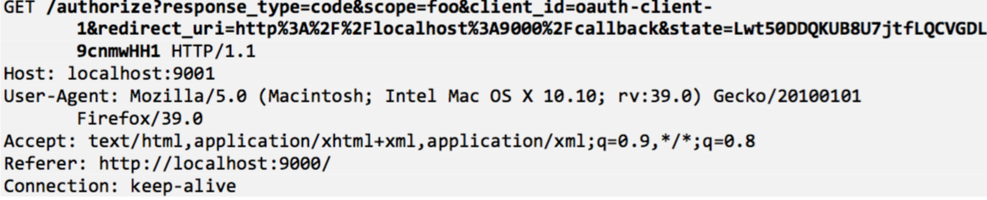
Redirect – Browser’s Http Get Request

Slide 7
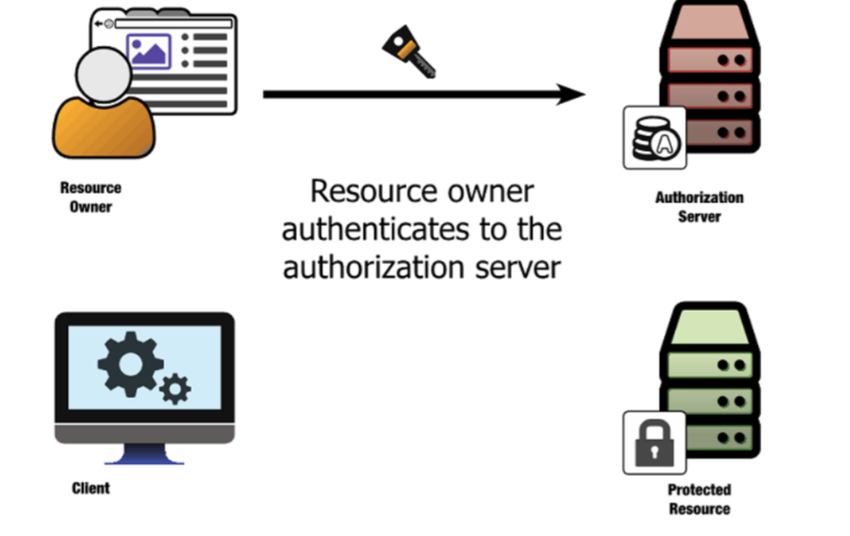
User Authentication
Authentication process is never seen by the Client
Authentication happens through browser
Oauth doesn’t specify which authentication scheme to use
username/password pair, cryptographic certificates, security tokens, federated single-sign-on, or any number of other possibilities

Slide 8
Delegating Access
The resource owner chooses to delegate some portion of their authority to the client application
The client’s request can include an indication of what kind of access it’s looking for (known as the OAuth scope)

Slide 9
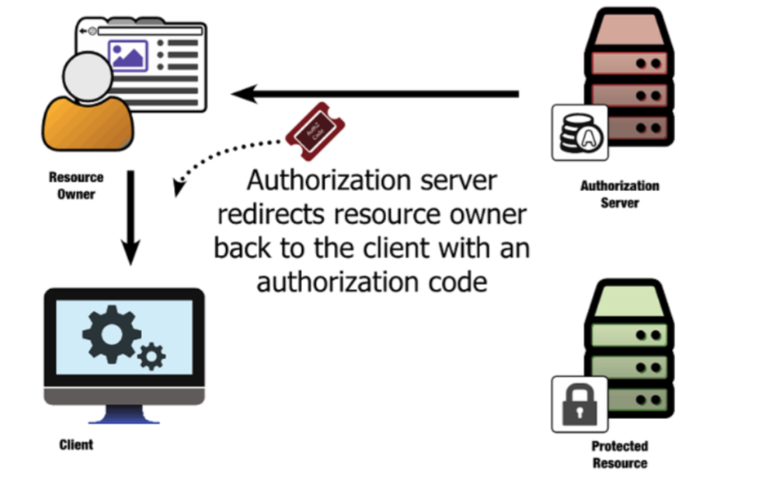
Authorization Code

Slide 10
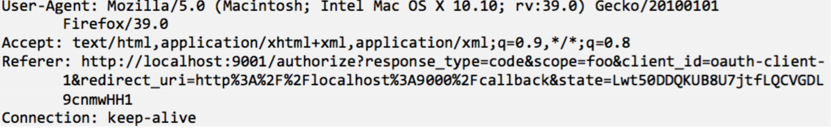
Authorization Server’s response to Browser
Browser sends Http Request to Client
Notice the Http Request is to Client, not to Authorization Server

Slide 11
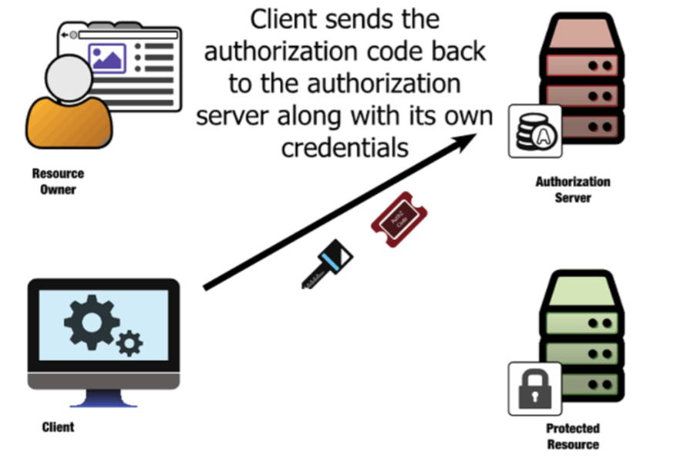
Client Sends Auth Code to Authorization Server

Slide 12
The client performs an HTTP POST with its parameters as a form-encoded HTTP entity body, passing its client_id and client_secret as an HTTP Basic authorization header
This HTTP request is made directly between the client and the authorization server, without involving the browser or resource owner at all.

Slide 13
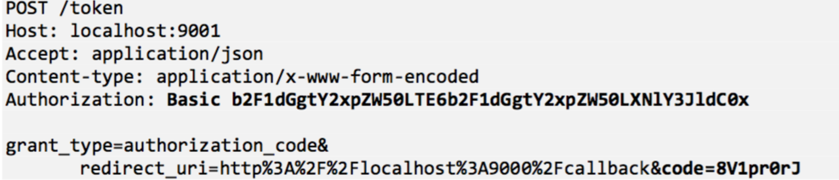
Client Http Post to Authorization Server

Slide 14
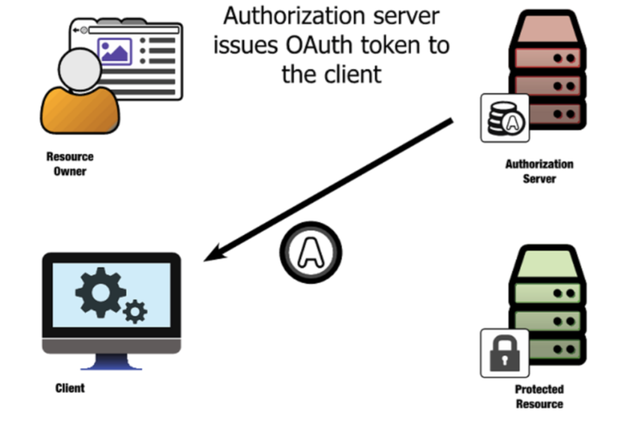
Issuing the Access Token

Slide 15
Issuing the Access Token
The Authorization Server performs a number of steps to ensure the request is Legitimate:
It validates the client’s credentials (passed in Authorization Header) to determine which client is requesting access
It reads the code parameter from the body and check that the code hasn’t been used yet
It makes sure the client is the same client who makes the original request
After the above steps, the Authorization Server issues the Access Token to the client

Slide 16
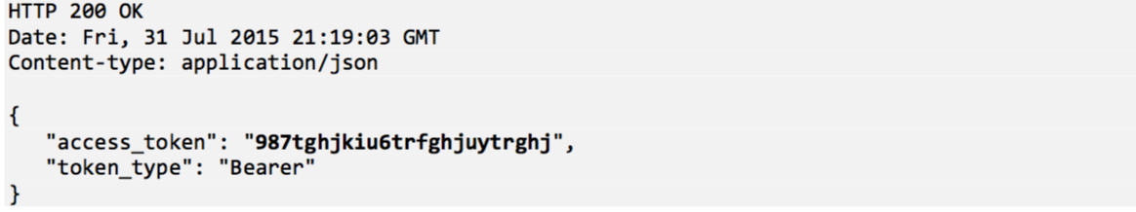
Authorization Server’s Response
In this case, we have a bearer token
The response can also includes a refresh token
The response can also incudes additional information such as scope and expiration time

Slide 17
Bearer Token
The core OAuth specifications deal with bearer tokens, which means that anyone who carries the token has the right to use it.

Slide 18
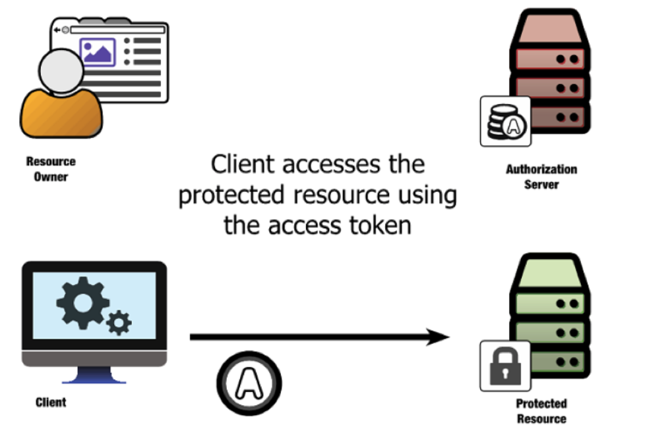
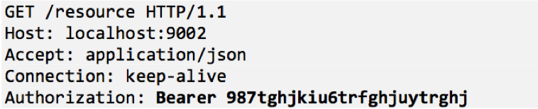
Client Access Resource with Access Token

Slide 19
Resource Server Addressing Access Token
The protected resource can then parse the token out of the header, determine whether it’s still valid, look up information regarding who authorized it and what it was authorized for, and return the response accordingly.
A protected resource has a number of options for doing this token lookup
The simplest option is for the resource server and the authorization server to share a database that contains the token information.
The authorization server writes new tokens into the store when they’re generated, and the resource server reads tokens from the store when they’re presented.

Slide 20
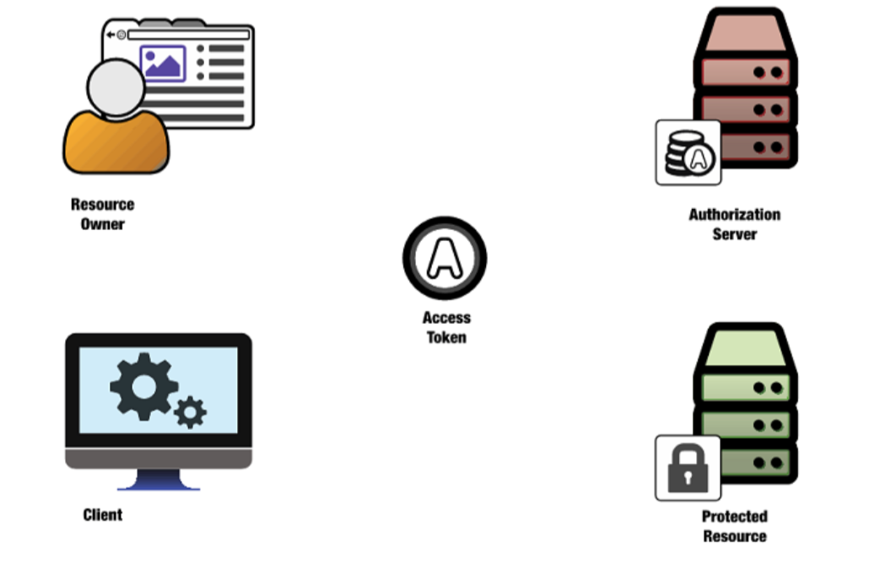
Oauth Roles: Client, Authorization Server, Resource Owner and Protected Resource

Slide 21
Oauth Roles: Client, Authorization Server, Resource Owner and Protected Resource
An OAuth client is a piece of software that attempts to access the protected resource on behalf of the resource owner, and it uses OAuth to obtain that access.
An OAuth protected resource is available through an HTTP server and it requires an OAuth token to be accessed. The protected resource also has the responsibility to validate the token.
A resource owner is the entity that has the authority to delegate access to the client. In most cases, it’s a user accessing web browser.
An OAuth authorization server is an HTTP server that acts as the central component to an OAuth system. The authorization server authenticates the resource owner and client, provides mechanisms for allowing resource owners to authorize clients, and issues tokens to the client.

Slide 22
Oauth components: Token, Scope and Authorization Grant
Access Token
OAuth does not define a format or content for the token itself, but it always represents the combination of the client’s requested access, the resource owner that authorized the client, and the rights conferred during that authorization
OAuth tokens are opaque to the client, which means that the client has no need (and often no ability) to look at the token itself.
The client’s job is to carry the token, requesting it from the authorization server and presenting it to the protected resource

Slide 23
Oauth components: Token, Scope and Authorization Grant
Scope
An OAuth scope is a representation of a set of rights at a protected resource.
Scopes are represented by strings in the OAuth protocol, and they can be combined into a set by using a space-separated list.
Scopes are defined by the protected resource, based on the API that it’s offering.
Clients can request certain scopes, and the authorization server can allow the resource owner to grant or deny particular scopes to a given client during its request.

Slide 24
Oauth components: Token, Scope and Authorization Grant
Refresh Token
An OAuth refresh token is similar in concept to the access token, in that it’s issued to the client by the authorization server and the client doesn’t know or care what’s inside the token.
What’s different, though, is that the token is never sent to the protected resource.
Instead, the client uses the refresh token to request new access tokens from Authorization Server without involving the resource owner

Slide 25
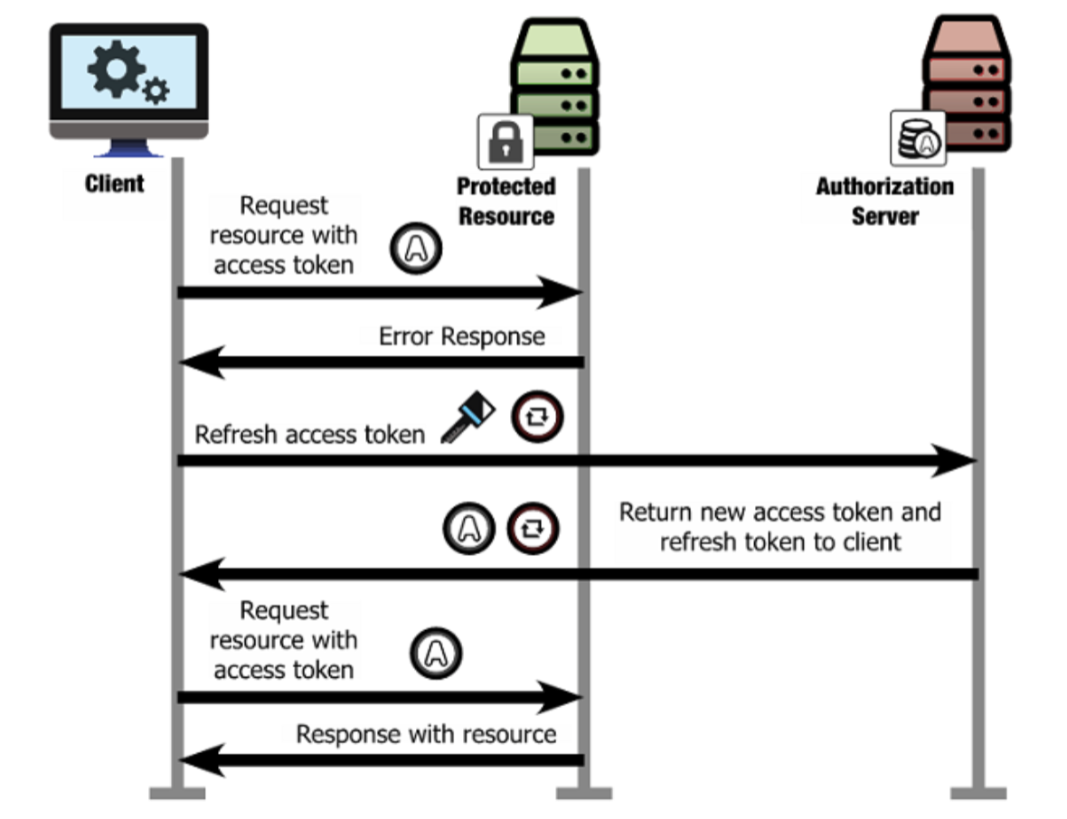

Slide 26
Oauth components: Token, Scope and Authorization Grant
Why do we need a refresh Token?
The user could have revoked the token
The token could have expired
Or some other reasons have made the access token invalid
The client could have the resource owner authorize it again, but what if the resource owner’s no longer there?

Slide 27
Oauth components: Token, Scope and Authorization Grant
Authorization Grant
An authorization grant is the means by which an OAuth client is given access to a protected resource using the OAuth protocol
In other words, the authorization grant is the method for getting a token

